Slide 1
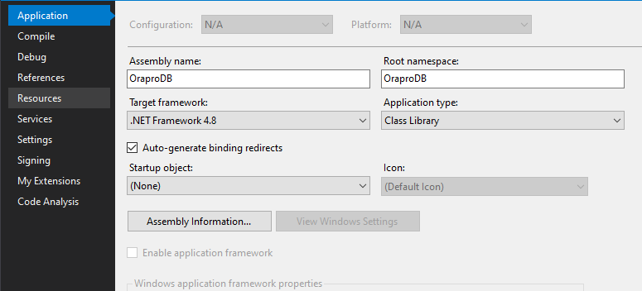
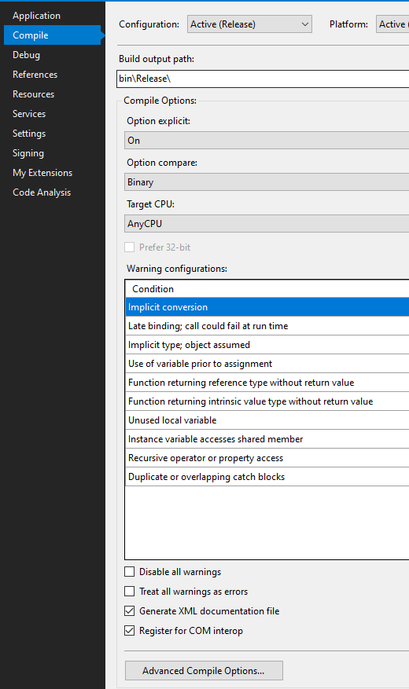
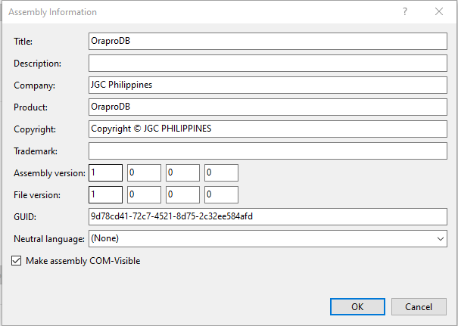
Excel & Visual Studio Database Connection Without Oracle Client
A. Creating DLL in Visual Studio
1. Create a Class library in Visual Studio and install Managed Data Access from Nugget.
2. Under Project Properties in Visual Studio. Select Application the Assembly Information
4. Navigate to Compile then Check “Register for COM interop”
3. Check the “Make assembly COM-Visibl”e
5. Open Visual Studio as administrator then Build Application to generate dll and tlb file. It will be in the Bin folder

Slide 2
B. Client Computer Setup
DLL Registration (Skip this step if using the batch file in Sharepoint)
Copy the dll and tlb file to client PC inside c:\windows\syswow64
Copy Oracle.ManagedDataAccess.dll to client PC inside c:\windows\syswow64
Open Command Prompt as Administrator
Navigate to C:\Windows\Microsoft.NET\Framework\v4.0.30319
Run “asmreg.exe c:\windows\syswow64 your_dll_file.dll /codebase”
Run regsvr32 c:\windows\syswow64 \ Oracle.ManagedDataAccess.dll
DLL Registration (Skip this step if using your own dll from Visual Studio)
From CIT page in sharepoint navigate to Manuals / Excel Managed Data Access
Download All files and copy to a single folder in client pc
Open command Prompt in Administrator Mode
Run dataaccess.bat

Slide 3
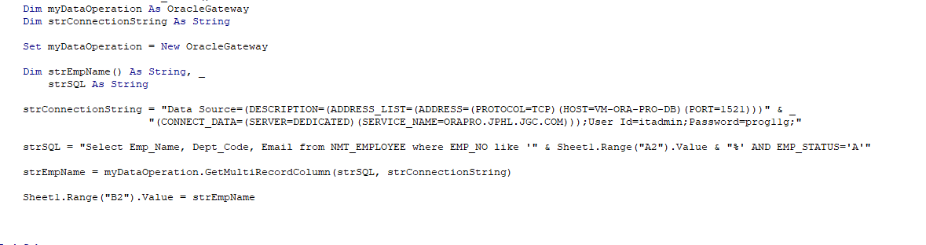
C. Excel Reference
Inside Visual Basic Code Editor Navigate to Tools -> References
Click browse and navigate to tlb file (c:/windows/syswow64)
After selecting the tlb file it should appear in the reference list
Sample Code in Excel

Slide 4
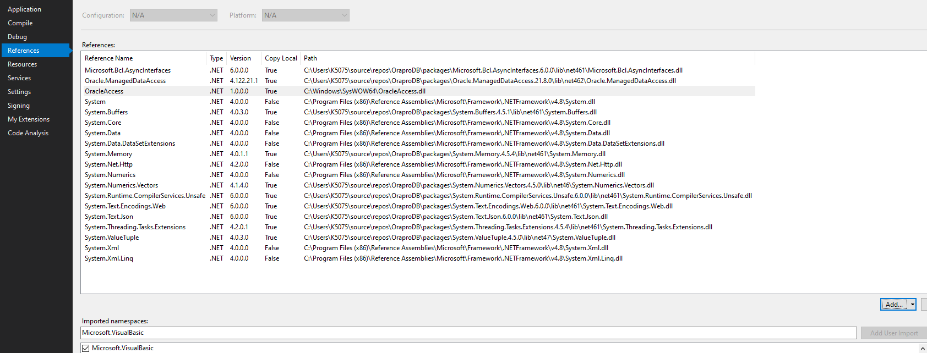
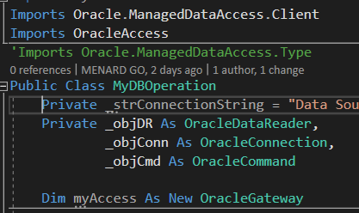
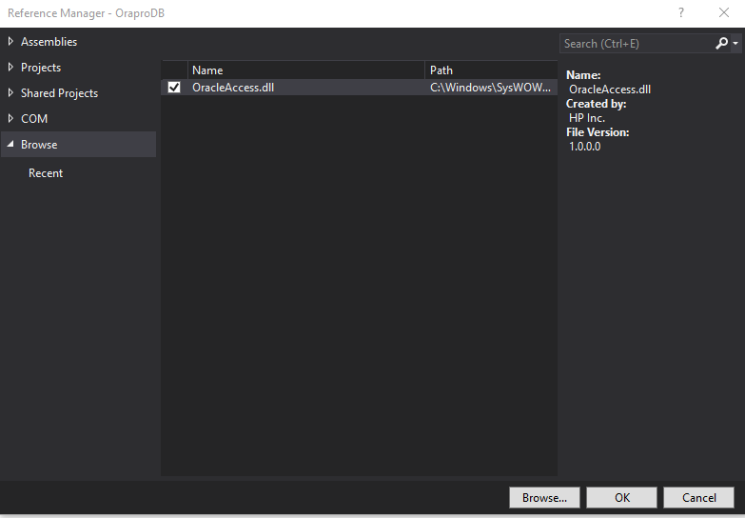
D. Add registered dll to Visual studio project
Under Project properties, navigate to Reference then click Add
5. Import OracleAccess
6. OracleGateway Class can now be accessed
2. Navigate to Browse and click Browse
3. Select your dll in c:\windows\wowsys64
4. Tick the check box on the dll
Note:
1) Make sure you are using DotNet 4 version
2) Make sure to use the browse option and point to the dll in wowsys64. The OracleAccess in the COM navigation bar points to the tlb file which cannot be used by Visual studio.

Slide 5
D. API
Function Name | Process | Return if Successful Query | Return if error in Query
InputUpdate | Add / Delete / Update Operation | True | False
GetSpecificUpdate | Use if expecting to receive a value from a single cell | Returns a single output from 1st line item 0 of Object reader | Blank string
CheckExist | Check if query will result for a column of 1 or more | True for 1 or more rows False if 0 rows | False
GetMultiRecordColumn | Retrieves value with dynamic rows and column | Returns a 1d array. Columns are separated by ~ | Err: & error message
Get MultiRow | Retrieves value with single column multiple rows | Returns a 1d array | Err: & error message
GetMultiColumn | Retrieves value with single row and multiple columns | Returns a 1d array | Err: & error message

